Slide 1
What’s this thing called “new statistics” and why might it be useful to me?
Charles Sullivan & Judy Oakden
ANZEA conference
November 2024
Notes:
Kia ora I’m Judy
Explain about Charles being online.
Kia ora I’m Charles

Slide 2
Why I learned more about statistics than I wanted to
Awkward combination in an evaluation
Small measured impacts (ceiling effects with rating scale) +
Small sample sizes (keen to report on subgroups such as Māori, low SES) =
Big risk that my report unclear, confusing
Notes:
Judy: I rang Charles for some quick advice.
Ended up reading a 200-page textbook on statistics!
Trashed my weekend.
Maybe the takeout is: don’t ring Charles, he might ruin your weekend.
I kept reading the textbook because New Statistics fits well with how I work as an evaluator.
Fits well with the complexity perspectives I use.
The New Statistics quickly useful in 3 of my evals
So worth sharing with you today
CS: In evaluations, it’s often combinations of problems that are hard.
I was careful about the statistics when Judy rang because of a combination of two problems.
One was a measurement problem – small measured impacts because of the rating scales used before and after.
Second problem was small sample sizes.
That combination meant that the report risked being very confusing if we used traditional statistics.

Slide 3
Overview
What? | What’s ‘the new statistics’?
So what? | How might some of ‘the new statistics’ ideas be useful to you?
Next what? | Next steps for you, for NZ eval?
Notes:
CS: Three things we want to do today
1 Clarify. What does “the new statistics” mean? 2 Suggest change. How might you use some new statistics ideas or our tips about using those ideas to change your evaluations?
3 Reflect. At the end, discussion. We’d like to learn from you about next steps.

Slide 4
Take-home messages (re so what?)
Favour confidence intervals over p<.05 etc How much…? focus rather than Is there a difference? (Yes/No)
Minimise “statistically significant” wording
Using meta-analysis to summarise results can be fairly simple and useful
Notes:
CS: Expanding on the “So what” part of the last slide, a heads-up on 3 things we’ll suggest you might change.
How much you change will differ depending on when and where you learned statistics, and how much of this you’re already doing.
We’re also aiming to encourage you to get these messages across to your seniors if you know this stuff already, but management blocks you using it. Many quant evaluations don’t need so much focus on questions like “Is there a difference?” Or statistical significance
But the awkward combination of small measured impacts and small sample sizes mentioned a couple of slides before meant we had to deal with those issues repeatedly.

Slide 5
Origins
Context
Notes:
Charles
So where did this stuff all start from

Slide 6
Historical perspectives …
A. No real change in 80 years
B.
Important changes in last 20 years (in both statistics and social science)
Notes:
CS: Perspectives A& B both have important truths.
The statistics of The New Statistics are not new (perspective A).
But using them as main way to analyze data is new (perspective B).
We focus on B today.
Because we’re suggesting that important changes in last 20 years not yet reflected enough in eval practice.
How ‘new’ it is to you will vary depending on when and where you learnt stats.

Slide 7
A: Old school
1925 Fisher popularizes p<.05 & significance test
1933 Neyman & Pearson: hypothesis testing
1940s onwards: textbooks start teaching hybrid ‘Null hypothesis significance test’ (NHST).
Cookbook-style
Silent re Fisher’s bitter clashes with Neyman etc
1990s. Proposals to ban NHSTs in journals. But little change in reporting.
“After 4 decades of severe criticism, the ritual of NHST… still persists” (Cohen, 1994; prominent scholar in a leading psychology journal)
Notes:
CS: Perspective A
From the 1940s there was a strong focus on significance testing.
NHST, Null hypothesis significance testing, was focus of stats I learnt at uni around 1980.
Both in psychology, my main subject, and from the stats department.
The 1990s had stronger rumblings of discontent. But little real change.
I mention this ancient history to encourage younger evaluators to challenge people my age. And to challenge whether following precedents in old reports of the organization where you work is still good practice today.
BACKGROUND ONLY:
Was Fisher or Neyman-Pearson right? That way lies madness:
“The dispute over formulations is unresolved. Science primarily uses Fisher's (slightly modified) formulation as taught in introductory statistics. Statisticians study Neyman–Pearson theory in graduate school. Mathematicians are proud of uniting the formulations. Philosophers consider them separately. Learned opinions deem the formulations variously competitive (Fisher vs Neyman), incompatible^{[2]} or complementary.^{[6]} The dispute has become more complex since Bayesian inference has achieved respectability.” Statistical hypothesis testing – Wikipedia
Context matters. “Fisher thought that hypothesis testing was a useful strategy for performing industrial quality control, however, he strongly disagreed that hypothesis testing could be useful for scientists.”
Some illustrations of criticism that NHST shrugged off:
J Cohen 1994. The earth is round (p < .05). American Psychologist, 49, 997-1003.
American Psychologist. This paper also an address for lifetime award from Society of Multivariate Experimental Psychology “After 4 decades of severe criticism, the ritual of null hypothesis significance testing—mechanical dichotomous decisions around a sacred .05 criterion—still persists. This article reviews the problems with this practice…”
* NB. This Cohen is a major figure. E.g. Cohen’s d, effect size measure discussed in our ERT tech note, that’s his name. And Cohen’s kappa.1994, relatedly. APA publication manual then ‘encourages’ effect sizes. But little change occurs
1998 Epidemiology banned NHST. Editorial: “you can . . . enhance your prospects if you omit tests of statistical significance. . . . In Epidemiology, we do not publish them at all. . . “ Editor was Rothman, author of widely used epi text.
1999. Leland Wilkinson and the Task Force on Statistical Inference. American Psychologist, “Some had hoped that this task force would vote to recommend an outright ban on the use of significance tests in psychology journals.”

Slide 8
B: More recently
2010 APA Publication Manual: “Confidence intervals…, in general, the best reporting strategy”
2010s Replication crisis, p-hacking concerns, etc
2015 a psych journal bans NHST
2017 textbook on The New Statistics (Geoff Cumming; 2nd ed in 2024).
The statistics (CIs & effect sizes & meta-analysis) not new. But using them as main way to analyze data is.
2019 American Statistician editorial has heading: Don’t Say “Statistically Significant”
Notes:
CS: Perspective B.
Since about 2010, change has been clearer.
Clear in statistics, psychology, medicine. But evaluation lagged?
E.g. 2015 chapter on “Using Statistics in Evaluation” in a major evaluation handbook :
“The primary application of inferential statistics is statistical hypothesis testing”. Newcomer & Conger, 2015 (p601)
They put confidence intervals secondary, wrongly. They should have put estimation (confidence intervals, effect sizes, meta-analysis) ahead of blunt yes/no hypothesis testing.
The 2019 American Statistician editorial wasn’t just for statisticians. Next slide shows it was part of much broader scientific movement.
BACKGROUND ONLY:
Precursor re replication/replicability crisis: Ioannidis JP (August 2005). "Why most published research findings are false". PLOS Medicine. 2 (8): e124. doi:10.1371/journal.pmed.0020124. PMC 1182327. PMID 16060722.
Fuller context for 2019 heading: Don’t say stat sig
“… it is time to stop using the term “statistically significant” entirely. Nor should variants such as “significantly different,” “p < 0.05,” and “nonsignificant” survive, whether expressed in words, by asterisks in a table, or in some other way” Source: The American Statistician, 2019. Special issue -- Statistical Inference in the 21st Century: A World Beyond p < 0.05. From Editorial (Wasserstein et al). Reflects thorough work: Editorial before 43 papers by many leading statisticians after 2-day symposium in 2017.
More progress examples
“Second, the Publication Manual of the American Psychological Association (APA) now recommends: “Wherever possible, base discussion and interpretation of results on point and interval estimates” (APA, 2010, p. 34).
Cumming, Geoff. Understanding The New Statistics: Effect Sizes, Confidence Intervals, and Meta-Analysis (Multivariate Applications Series) . Taylor and Francis. Kindle Edition.
APA manual used by 1000+ journals across disciplines.
Cumming 2012, text introducing New Statistics
The main message of this book is that we should shift emphasis as much as possible from NHST to estimation, based on effect sizes and confidence intervals.”
NB. He still presents NHST, and hedges with “as much as possible”.

Slide 9
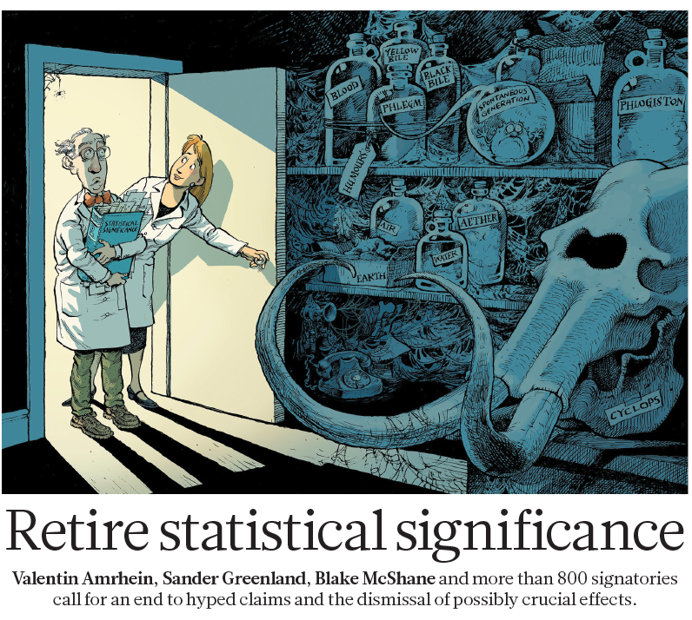
2019 push to ban “stat sig” wording not just in statistics journal. Also in Nature, with 800+ signatories. But: impact on eval??
Notes:
CS: Cartoon suggests it was time to abandon “statistical significance”, chuck it into the ancient history museum with outmoded ideas like yellow bile & phlogiston.
It was in Nature, the very prominent science journal. With 800 signatories.
But we didn’t see impact in evaluation of this.
Did you? Keen to hear if you did, in discussion part of the session.
Conference themes. This relates to Wallis and Futuna (Wallisian) saying.
Ka tā te fala pea tu‘u o me‘e.
When you hear the beat, get up and dance
We think that evaluation missed hearing ‘the beat’ of this change in 2019. Eval missed joining the ‘dance’ then, and earlier.
Full disclosure. 2 years later, the American Statistical Association did pullback from the 2019 editorial recommending an outright ban on saying “stat sig”. They clarified that such a ban was not official ASA policy. Even so, the 2019 heading “Don’t say “Statistically Significant” and articles with it remain great warnings about trad stats.
BACKGROUND Source of cartoon: 2 1 M A R C H 2 0 1 9 | VO L 5 6 7 | N AT U R E | 3 0 5
2021 pullback “a 2019 editorial … might be mistakenly interpreted as official ASA policy. .. Purpose… to clarify that the use of p-values and significance testing, properly applied and interpreted, are important tools that should not be abandoned [emphasis added]” AmStatNews, the membership magazine of the American Statistical Assoc
(2021).

Slide 10
1.
What’s ‘the new statistics’?
Notes:
CS: Let’ start by clarifying what this stuff is

Slide 11
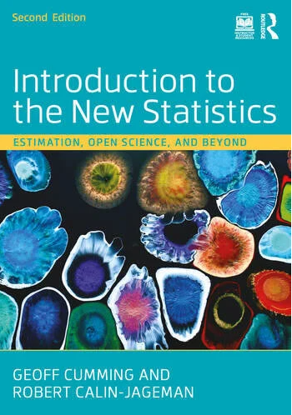
New stats resources
thenewstatistics.com
Introduction to the New Statistics (2nd ed). G Cumming & R Calin-Jageman, (2024)
Notes:
CS: You can get into this yourself.
Statistics techniques in these resources have little not in traditional courses.
But the emphasis/perspective different, and more useful for eval
Judy:
I’ve used these materials.
I do suggest you have someone statistical check your work the first time.

Slide 12
In brief
Use “effect sizes, confidence intervals, and meta-analysis—to avoid problems associated with null-hypothesis significance testing”
Relax!
The statistics (confidence intervals, effect sizes & meta-analysis) not new. But using them as main way to analyze data is.
DIY learning feasible -- materials on previous slide.
Notes:
CS: The gist is de-emphasising hypothesis testing in favour of effect sizes, confidence intervals and meta-analysis. Some of you will have learned that without the label “New Statistics”. Depends where and when you learned your stats.
Relax message important: lot’s of this is a change in emphasis, what we focus on as the main way of analysis and communication.
The point about the statistics not being new has a subtle implication too. It’s a reason evaluators who developed their quant reporting habits 20 years ago may have seen no clear reason to change as suggested by New Statistics. Several of these changes simply aren’t as obvious as the emergence of entirely new statistical tools, such as the creation of the IDI (Integrated Data Infrastructure).
BACKGROUND
Source for new stats definition: Psychological Science journal submission guidelines https://www.psychologicalscience.org/publications/psychological_science/psci-submissions

Slide 13
1a.
Yay for confidence intervals
Down with rejecting the null hypothesis, p<.05
Notes:
CS: Our first take-home message.
On the surface, may seem straightforward to many of you.
Both confidence intervals and hypothesis testing in basic stats courses decades ago.
But emphasis then on hypothesis tests.
The new statistics reverses that emphasis, in favour of confidence intervals.

Slide 14
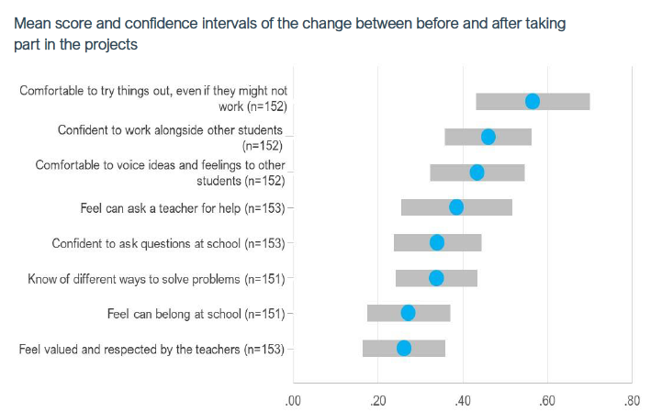
Notes:
Judy:
Let’s see some examples from local evaluations.
Blue dots show average change, size.
Grey bars show 95% confidence interval around each average.
Gap between grey bar and 0 can be used to infer statistical significance.
Strengths and weaknesses cf traditional stats?
E.g. Alternative here would be lots of p-values testing null hypothesis that true change was 0
p-values largely useless clutter with this evaluation
All p-values would be very small and clearly significant. But so what?
Distract from more important issues for evaluation like: how valuable are changes of this size?
Confidence intervals show that changes clearly differ from 0. But don’t over-emphasise that.
BACKGROUND
Creatives in Schools Programme Evaluation Report Round 4, 2023 (p66)
https://www.educationcounts.govt.nz/publications/schooling2/curriculum/creatives-in-schools-programme/creatives-in-schools-programme-evaluation-report-round-4-2023

Slide 15
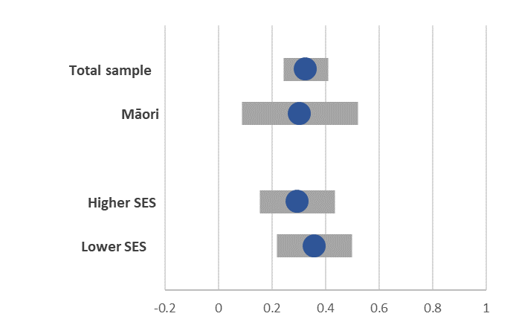
What’s good about the confidence intervals here?
Mean change in ratings (pre to post)
Notes:
CS: A slightly more complex example. Because of some smaller sample sizes.
I like that the confidence intervals
1. Show precision and uncertainty well. In particular, lower precision / greater uncertainty for smaller subgoups, such as Māori.
2. More subtly, they communicate similarity well.
Higher SES similar to Lower SES, even if the means differ
BACKGROUND: Source and data details deliberately blanked. But arose from real evaluation 3. Do two things at once (tricky to communicate otherwise)
Shows similarity of groups + …
Shows whether or not all the confidence intervals clear of 0 (no change)

Slide 16
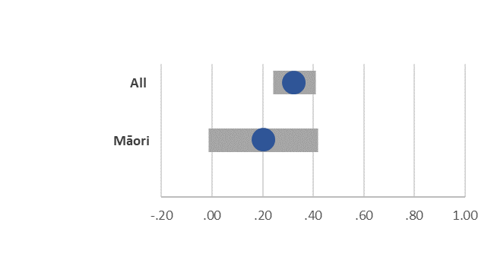
Imagine slightly different results for same example… compare Old-school vs New stats
 | Mean change | p | Significant?
All | 0.33 | <.001 | ***
Māori | 0.20 | .06 | Not significant
Mean change in ratings (pre to post)
Notes:
Presenter: 2 builds.
CS:
Trad stats approach in table. What’s main message?
Program works overall, but no significant evidence that works for Maori?
Hidden is the lower precision for Maori
New stats approach in graph with confidence intervals
Shows Maori mean similar to All.
it also shows there’s no clear evidence that average change for Maori is above zero.
Think about difference in perspectives, emphases
With confidence intervals can still infer that Maori mean not significantly greater than 0. OK, true.
But the eye simultaneously sees the similarity to the result for All, plus is warned about the lower precision for Maori. Because of smaller sample size
The trad stats approach seems misleading and unbalanced for such results.
BACKGROUND:
Only change to real data: Maori results reduced by 0.1 (which could have happened from random sampling variation)

Slide 17
Tips: Some hurdles to be aware of
Extra time | Quicker just to type means/averages without CIs or a graph
Precedent lacking? | Earlier related reports may lack CIs. Many professional reporting habits started when it was harder/slower to produce graphs + older generation overtrained in NHST
Excel | Default style for CIs is weak
Notes:
Even if you already know this stuff technically, there are practical hurdles when you try to do it.
About our point at the bottom on Excel default style being bad.
The Excel default emphasises that something special happens at the very end of the confidence intervals.
Our grey bars showed estimates with indications of uncertainty around them. Nothing highlighted in them about end of the grey bars. So they didn’t emphasise a big blunt distinction between sig vs not sig.
The fat grey bars in our examples used a template from Stephanie Evergreen’s website.
BACKGROUND Optional question slide at end with better conceptual/teaching image of confidence interval
Free resource: https://stephanieevergreen.com/adding-confidence-intervals-to-a-dot-plot/
Excel default error bars weak because:
Caps at end emphasise the endpoints and related hypothesis testing
Caps at end distract from bulk of the distribution being around the middle
Hence we use fatter grey bars, without end caps

Slide 18
1b.
Minimise use of “statistically significant”
Notes:
Moving on to our second take-home message.
BACKGROUND
This wording often a barrier to evaluation as “collaborative social practice”
Source of “collaborative social practice”. Thomas Schwandt, 2018. https://onlinelibrary.wiley.com/doi/abs/10.1002/ev.20318

Slide 19
What’s the problem?
Statistically | Don’t think, don’t question, elitist, intimidates?
Significant | Often misleads re practical importance of the change/difference
Statistically significant | Has both problems above. And the combination may confuse many even if they feel OK about each word individually.
Notes:
CS: Two words, both have problems.
Plus remember that combinations of small problems can often be a big problem.
These wording problems seem more damaging for evaluation than in academic reports.
Because we’re often sharing results with the community. Or sense-making with people who are not trained in statistics.
So we should worry about wording that they may find elitist or intimidating.
Judy: The problem with “significant” was clear in a project we did 20 years ago. The sample was so large, over 8000. That’s so large that most differences you look at are statistically significant. But few of those differences are important practically, most too small to be important or useful.
BACKGROUND
Many students in stats exams confused about meaning just after swotting.
Why would we expect them to understand well years later at work?

Slide 20
Hurdles to beware of
No wording replacement for ‘stat sig’ that is short & simple & correct
Pushback to alternatives likely
“Seductive appeal—the apparent but illusory certainty—of declaring an effect ‘statistically significant’” Cumming (2014)
Notes:
Judy: Even when you know New Statistics, replacing “statistically significant” can be hard.
Hence our warning “here be dragons”!
Specialists may warn about the ‘illusory certainty’ of stat sig as Cumming does. But our managers and clients may pushback against replacements that lack such certainty if they believe that stat sig wording is still good practice.
BACKGROUND
An entire paper on how no replacement is short & simple & correct: Spence & Stanley (2018) – Concise, simple, and not wrong
Here be dragons: “Misinterpretation and abuse of statistical tests, confidence intervals, and statistical power have been decried for decades, yet remain rampant. A key problem is that there are no interpretations of these concepts that are at once simple, intuitive, correct, and foolproof.” Greenland et al 2016 https://pubmed.ncbi.nlm.nih.gov/27209009/
Context of quote on slide: “Why is NHST so deeply entrenched? I suspect the seductive appeal—the apparent but illusory certainty—of declaring an effect “statistically significant” is a large part of the problem”
Cumming (2014, p11) The New Statistics: Why and How. Psychological Science 2014, Vol. 25(1) 7– 29

Slide 21
Some wording options
may not be zero | E.g. “indicating that the true effects may not be zero”. Or “there is reason to doubt that the true effects are zero”. Spence & Stanley (2018) – Concise, simple, and not wrong
real or meaningful | “A statistically significant difference is likely to represent a real change over time rather than a random variation due to the sampling process.” MoH/NZHS “Statistical significance shows whether any differences observed between two groups being studied are “real” or whether they are simply due to chance.” SportNZ
Avoid / minimise! | Finesse by focusing on confidence intervals [our preferred strategy in many contexts e.g. graphs earlier]
margin of error | Familiar from opinion polls – avoids ‘confidence interval’ where that’s too technical/statistical
Notes:
Judy to talk through
Our message is “minimise” use, not “Don’t” use at all.
Using it once or twice is often OK in a report, but not throughout.
Graphs with confidence intervals as in our earlier slides can reduce the number of times words like “stat sig” wanted
Context matters.
Stat sig often OK in a technical appendix. Because appropriate for readers seeking technical details.
Placing stat sig in a footnote that will not disturb readers unfamiliar with the meaning may work too.
BACKGROUND
some quotes from Spence & Stanley 2018 “Concise, simple, and not wrong” – whole article about this question
” describing the meaning of statistical significance to a non-scientific audience is especially difficult given the technical nature of a correct definition. Correct interpretations of statistical significance can be unintuitive, nuanced, and use unfamiliar technical language”
“Providing an intelligible and concise explanation of statistical significance can be hard to do without falling prey to common fallacies and misinterpretations”
“Effect sizes and confidence intervals can give information about what the effect may be, but statistical significance alone does not provide information about how large an effect may be – it just MAY not be zero. We suggest that this, “may not be zero,” interpretation is a simple, concise, and not incorrect interpretation of statistical significance
CS prefers “there is reason to doubt that the true effects are zero” from their options
“What is clear from this interpretation is that it is uninformative, bordering on meaningless. This is true and this is the nature of significance testing” (!)
History: Another possible option: “statistical difference” rather than “statistically significant difference”
“Kline (2004) recommended that if we use NHST, we should refer to “a statistical difference,” omitting “significant.” That is a good policy; the safest plan is never to use the word significant. The best policy is, whenever possible, not to use NHST at all.” Cumming 2014, p12
CS view: a reasonable suggestion at the time. But unfamiliar + too mysterious/confusing for our NZ eval audiences? Invites question not easily answered: what does “statistical difference” mean? Suggested in 2004 and hasn’t caught on yet.
This option mainly to illustrate the length of the struggle over this, even for international specialists.

Slide 22
1c.
Other ‘new statistics’ stuff
Other key themes (very briefly)

Slide 23
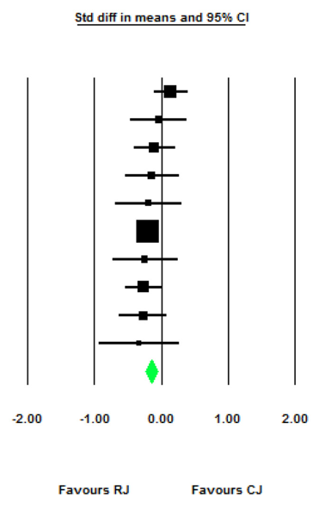
Meta-analysis
Restorative justice (RJ) example from Campbell Collaboration.
Meta-analysis (green diamond) shows small effect favouring RJ in reducing re-offending – traditional hypothesis testing would have missed that
Notes:
CS (Short version) Meta-analysis is a key New Statistics theme.
Main point today: it’s now in an introductory textbook aimed at year 1 uni students.
So don’t avoid this as something ‘advanced’ just because not taught when you went to uni.
CS (only IF time allows)
The online New Statistics resources we listed earlier include a spreadsheet that does meta-analysis.
So you can use it quickly to summarise a few studies. Meta-analysis is not just for big systematic reviews like Campbell or Cochrane.
Looking at the graph here, let’s try a traditional approach to summarising the 10 studies shown by the black squares and confidence intervals.
Summary 1: Restorative justice (RJ) doesn’t work. 9 of 10 experiments failed to find any significant effect compared to standard criminal justice (CJ)
Now focus on the green diamond, a key meta-analysis output
Summary 2: From 10 experiments, RJ reduces re-offending by a small but meaningful amount compared to CJ (standard criminal justice).
The difference between Summary 1 and 2 is important. Even this small reduction in offending was highly cost-effective. So the added value of meta-analysis is clear and important with the restorative justice data.
BACKGROUND
Source: Strang et al. Campbell Systematic Reviews, Volume: 9, Issue: 1, Pages: 1-59, First published: 04 November 2013, DOI: (10.4073/csr.2013.12)
Cost-effectiveness covered in sec 4.7
Illustration of the value of meta-analysis from SIDS, cot death
By 1970, meta-analysis could have shown clear evidence of risks of sleeping on the front. But meta-analysis not common practice then. Late introduction of ‘back-to-sleep’ campaigns reducing SIDS probably caused 50,000+ preventable infant deaths in Europe, USA, Australasia. Gilbert et al (2005)

Slide 24
Open Science (key new stats theme we lack time to illustrate)
Motivation | Replicability crisis in 2010s e.g. selective publication the .05 imperative lack of replication p-hacking
Key tools | Pre-registration of design, analysis plan Open data (lets others re-analyse/ check)
Notes:
CS: We’ve seen some local action on Open Science.
The new Australian Eval Centre started helping with one key tool for the Open Science approach: pre-registration
BACKGROUND
https://evaluation.treasury.gov.au/about/about-australian-centre-evaluation
Replicability crisis, aka replication crisis. Coined early 2010s.
Seminal paper with great title: Why most published research findings are false (Ionnidis 2005)
https://journals.plos.org/plosmedicine/article?id=10.1371/journal.pmed.0020124

Slide 25
2.
Next what?
Discussion about possible next steps for you, and ANZEA

Slide 26
Reflections
Past use | Have you come across this already in your work? How was it received?
Use now | Any projects you’re doing now where it might be useful to show changes in attitudes or behaviours?
Learning | What would you want to learn if you were going to use new statistics approach?
Support | Who might be useful support people?
ANZEA | Should ANZEA offer basic training?
Notes:
Judy

Slide 27
References
Amrhein V, Greenland S and McShane B (2019) ‘Scientists rise up against statistical significance’, Nature, 567(7748):305, doi:10.1038/d41586-019-00857-9.
Cohen J (1994) ‘The earth is round (p < .05)’, American Psychologist, 49(12):997–1003, doi:10.1037/0003-066X.49.12.997.
Cumming G and Calin-Jageman R (2024) Introduction to the New Statistics: Estimation, Open Science, and Beyond, 2 edition, Routledge, New York London.
Newcomer KE and Conger D (2015) ‘Using statistics in evaluation’, in KE Newcomer, HP Hatry, and JS Wholey (eds) Handbook of Practical Program Evaluation, Jossey-Bass, San Francisco
Spence JR and Stanley DJ (2018) ‘Concise, Simple, and Not Wrong: In Search of a Short-Hand Interpretation of Statistical Significance’, Frontiers in Psychology, 9, https://www.frontiersin.org/journals/psychology/articles/10.3389/fpsyg.2018.02185, accessed 8 February 2024.
Strang H, Sherman LW, Mayo-Wilson E, Ariel B and Woods D (2013) ‘Restorative Justice Conferencing (RJC) Using Face-to-Face Meetings of Offenders and Victims: Effects on Offender Recidivism and Victim Satisfaction. A Systematic Review’, Campbell Systematic Reviews, (12), http://www.campbellcollaboration.org/lib/project/63/.
Wasserstein RL, Schirm AL and Lazar NA (2019) ‘Moving to a World Beyond “p < 0.05”’, The American Statistician, 73(sup1):1–19, doi:10.1080/00031305.2019.1583913.
Notes:
BACKGROUND
Deliberately omitting minor one-off links in slides, and things only in background notes not visible on slides.

Slide 28
Just in case slides, for questions

Slide 29
Why are Excel default error bars bad for showing confidence intervals?
Notes:
Excel default style at left
Emphasizes end points of the confidence interval
That overemphasizes the binary significant/not significant perspective of hypothesis testing
“Plausbility picture” at right better for teaching/introducing confidence intervals
No shart endpoints
Grey distribution shows
that most plausible values in centre
some plausibility for values past the ends of confidence intervals, not zero chance.

Slide 30
What does “statistically significant” mean, strictly speaking?
Lead-in:
focusing on the usual 5% significance level only
H0 means “null hypothesis”).
“Suppose the study were repeated many times by drawing many random samples from very large population(s) where H0 is true. Less than 5% of these hypothetical results would be even more inconsistent with H0 than the actual result.”
Notes:
Some of you may feel we exaggerated difficulties of a wording replacement that is short & simple & correct.
This slide has the exact words of a leading expert.
Do our readers often want to see that kind of paragraph? Our clients, managers??
BACKGROUND
Source: Rex Kline, 2013, Beyond significance testing (2nd ed), p75
Alternative he puts first:
The exact level of significance is the conditional probability of the data (or any result even more extreme) assuming H0 is true, given all other assumptions about sampling, distributions, and scores.

